Slide 1
Part 3: Map APIs
Wenzheng Li, Yujin Lee

Slide 2
Schedule for today
Part 1: The applications of Google Map APIs
the geocoding API and distance matrix API
Part 2: Use OSMnx package to obtain OpenStreetMap dataset
Part 3: Interactive Mapping

Slide 3
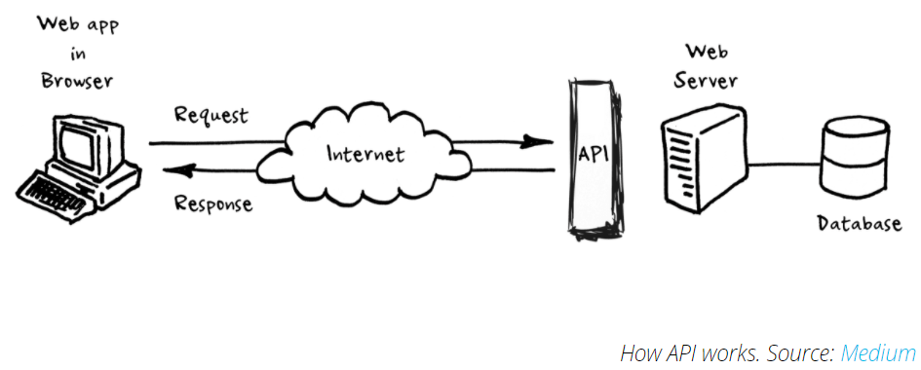
What is a web-based API (Application Programming Interface?
An API allows one program to talk to another program. Many websites or services provide an API so you can query for information or download datasets in an automated way.
We send an API a request detailing the information we want.
API can return data in response to a request made by a client.

Slide 4
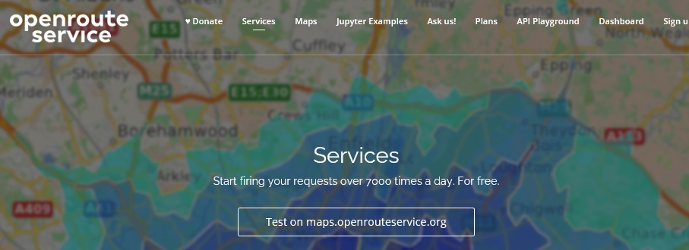
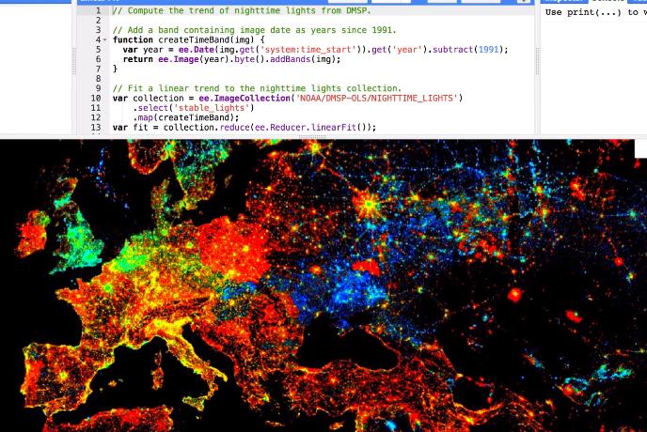
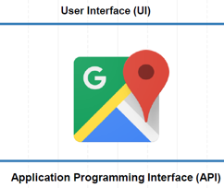
Map APIs
Map APIs for spatial analysis:
Getting travel navigation information (directions/distance/duration)
Route optimization (shortest distance, least time spent)
Geocoding (address to longitude and latitude)
Downloading data (obtain spatial entities from OSM and Google MyPlace)
Getting real-time weather data
....
Commonly used Map APIs:
OpenStreetMap Overpass APIs
Google Maps APIs
Google Earth Engine API
Baidu APIs
Notes:
OpenStreetMap (OSM) is a collaborative project aimed at creating a free, editable map of the world. Anyone can contribute to OSM by adding, editing, or updating map data. Contributors include individuals, organizations, and companies.

Slide 5
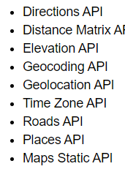
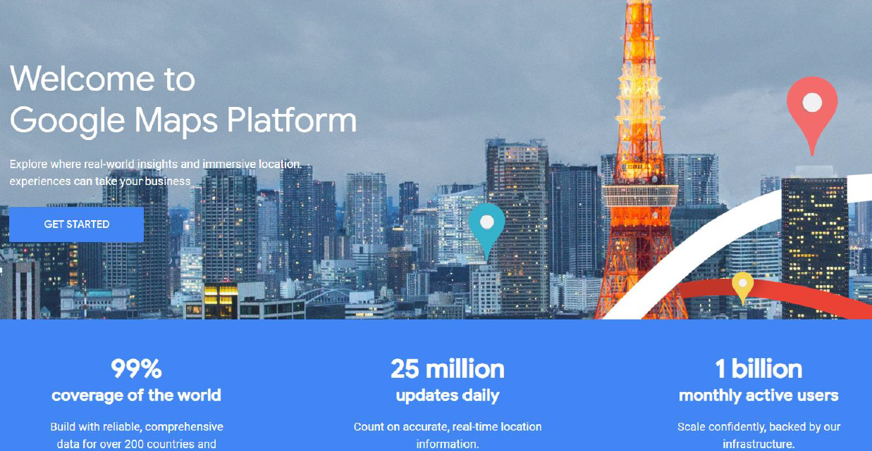
Google Map API (googlemaps library)
The Google Maps library provides us a list of applications using Google Map APIs:
for more: https://github.com/googlemaps/google-maps-services-python
Installation of Google Map API:
create a Google API account with an associated API Key. Please get your own API keys following this instruction: https://developers.google.com/maps/gmp-get-started#api-key.
the Python library for Google API is called googlemaps. To install the library, we type !pip install googlemaps
Once you have created a billing account and project you are eligible for the Google Cloud Platform $300 free trial and Google Maps Platform recurring $200 monthly credit. https://cloud.google.com/maps-platform/pricing/sheet/. Geocoding API: 0.005 USD per call
Notes:
The key is used to identify you and enforce usage limits so that you do not overwhelm the servers. I provide a key from my own account for instruction purpose. However, please get your own API keys following this instruction by the developer of the googlemaps library https://developers.google.com/maps/gmp-get-started#api-key.
The $200 monthly credit for the Google Maps Platform helps mitigate costs for ongoing projects that use mapping, routing, or location-based services.

Slide 6
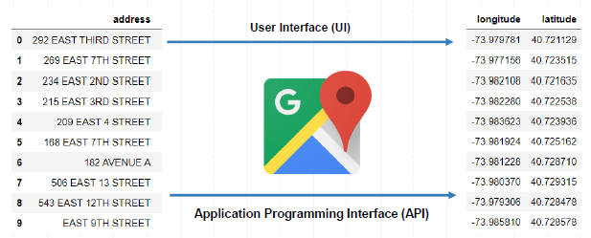
Basic Applications
In this section, we will introduce two basic applications
the Geocoding API which returns the corresponding longitude and latitude in terms of the address

Slide 7
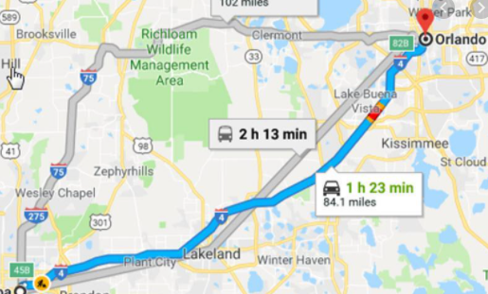
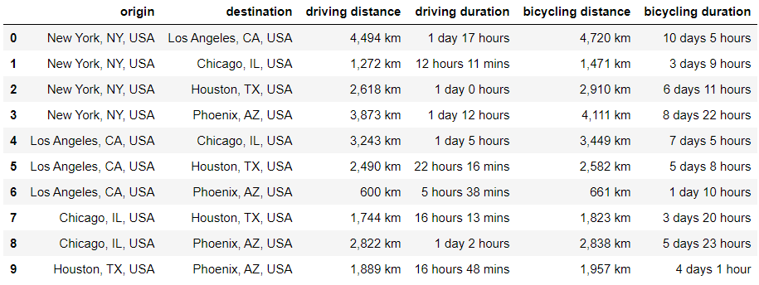
Basic Applications
In this section, we will introduce two basic applications
the Distance Matrix API which calculates the travel distance/time from one location to another in terms of travel modes.

Slide 8
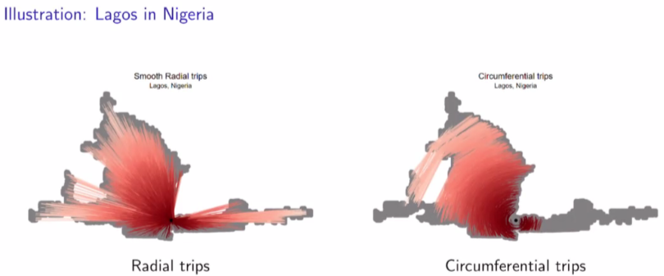
More Advanced Applications:
Akbar et al, 2018:
Obtain POIs from Google MyPlace
900M simulated “real time traffic” trips from Google Map
Compare the real-traffic time/distance with the hypothetic state of no traffic
Calculate traffic congestion for global cities

Slide 9
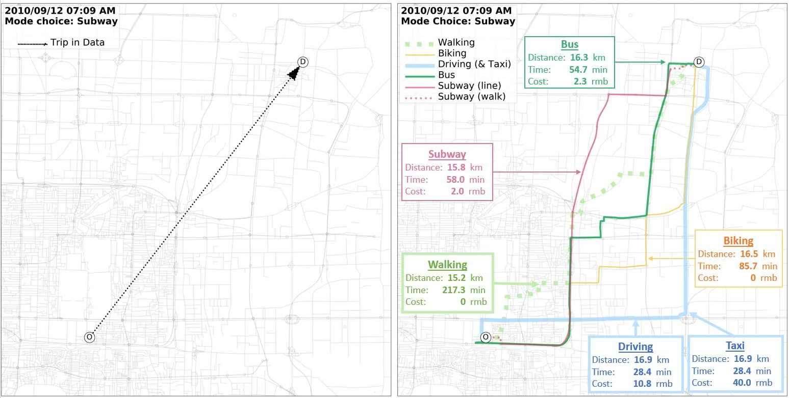
More Advanced Applications:
Li et al, 2020:
obtain the travel time, distance and costs based on different travel modes (driving, walking, bus, biking, and walking) for each OD pair
Value travel of time in Beijing

Slide 10
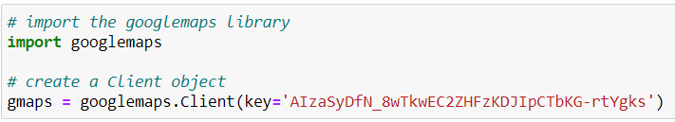
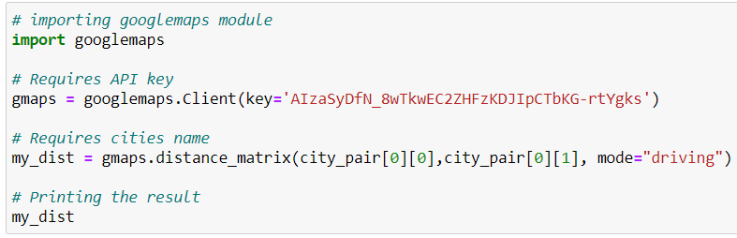
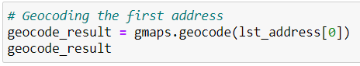
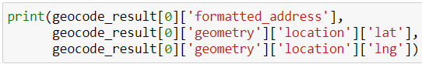
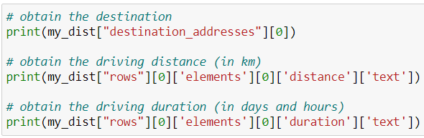
In today’s class:
1. Google Map API Geocoding application:
go to the Lab folder and load the COVID-19 NYC Vaccination sites dataset (COVID19_Vaccination.xlsx).
2. Distance Matrix API
Create city pairs: OD matrix of top five US cities

Slide 11
Part 2: Collecting OpenStreetMap Dataset using OSMnx
Wenzheng Li, Yujin Lee

Slide 12
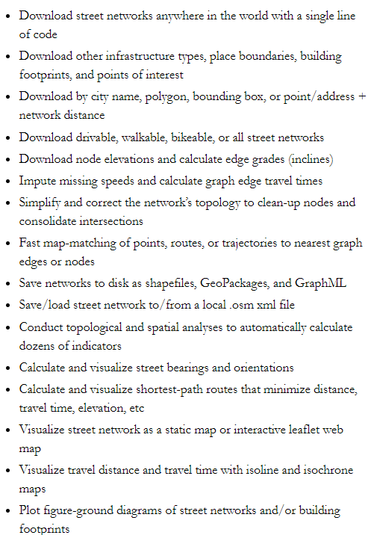
OSMnx?
Author: Geoff Boeing Urban planning and spatial analysis professor at USC
OSMnx features:
retrieve, analyze, and visualize street networks and other spatial data from OpenStreetMap.
OSMnx is on GitHub and you can install it with conda.

Slide 13
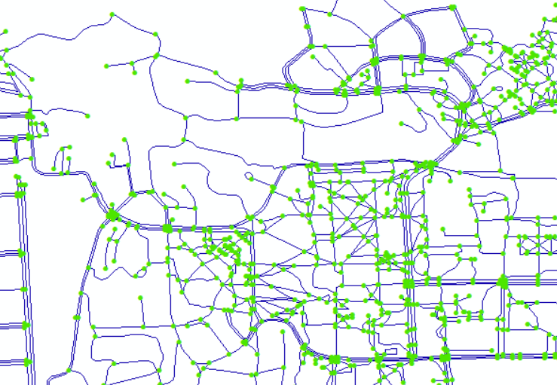
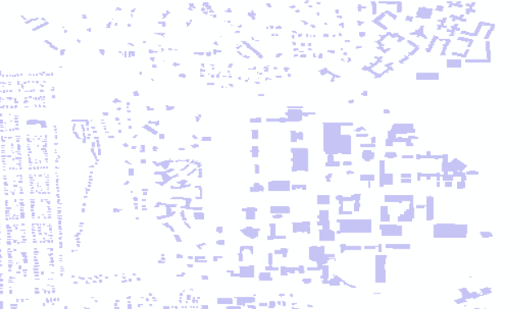
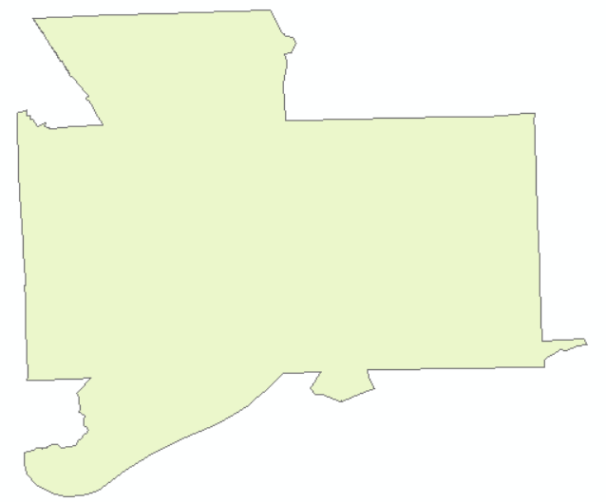
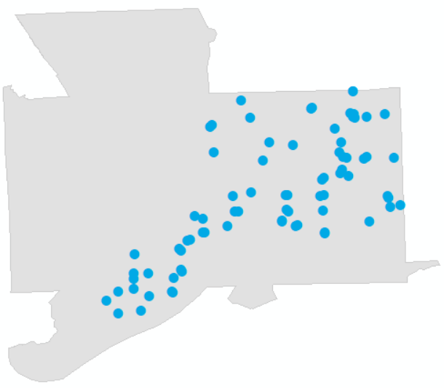
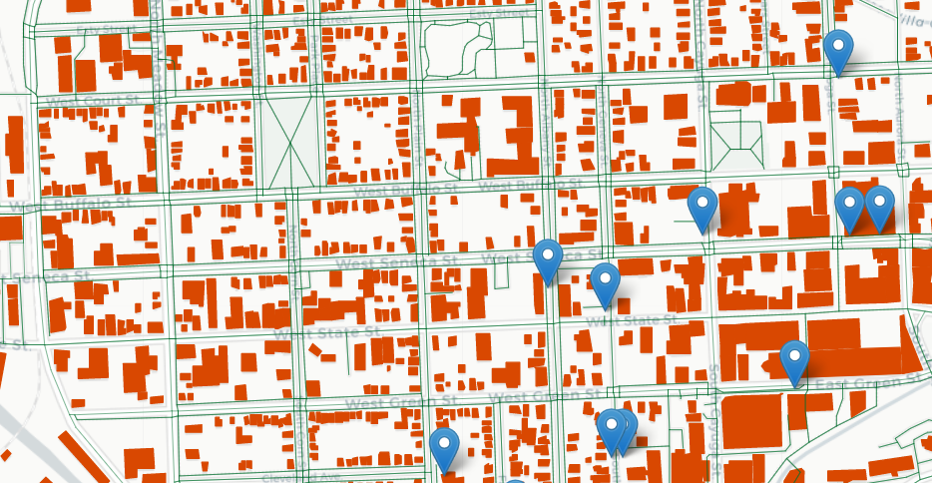
Street Network (edges and nodes)
Building Footprints
City Boundary
Bus stops
Interactive maps using folium

Slide 14
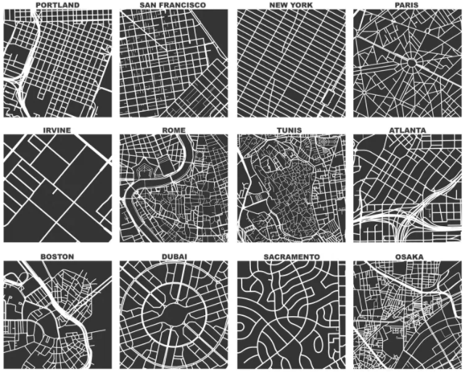
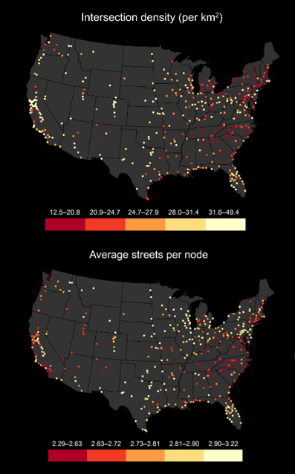
Advanced Applications:
Cities’ urban forms (Allan Jacobs, Geoff Boeing reproduce these figures using OSMnx)
Boeing, G. 2020. “A Multi-Scale Analysis of 27,000 Urban Street Networks: Every US City, Town, Urbanized Area, and Zillow Neighborhood.” Environment and Planning B: Urban Analytics and City Science, 47 (4)
Intersection density and average streets per node per urbanized area in the contiguous US

Slide 15
What we will do using OSMnx today?
(1) download street network dataset (both edges and nodes) of city of Ithaca
ox.graph_from_place(“Ithaca, New York, USA”)
nodes, edges = ox.graph_to_gdfs(graph) // convert to gdf
(2) download the boundary of City of Ithaca
ox.geocode_to_gdf (“Ithaca, New York, USA”)
(3) download building footprints
ox.geometries_from_place(query = “Ithaca, New York, USA”, tags = {'building': True})
(4) download POIs: bus stops
ox.geometries_from_place(query = “Ithaca, New York, USA”, tags = {'highway':'bus_stop’})
(6) visualize the OSMnx dataset

Slide 16
Questions?
More Readings: https://geoffboeing.com/

